Slide 1
12.7 Solving a system of homogenous linear ordinary differential equations

Slide 2
Introduction
In this topic, we will
Discuss how the differential operator is linear
See that the differential operator has eigenvalues and eigenfunctions
See how these eigenfunctions are used to find solutions to a system of ordinary differential equations
See that this results in unknowns, which can be fixed based on initial conditions
Remind ourselves that this is supplementary information
This will be taught in detail in second year

Slide 3
Eigenvectors of the differential operator
Recall that for u to be an eigenvector for a matrix A, we must have that Au = λu
Recall that the defining property of a linear operator is
A(α u + β v) = αAu + βAv
For differentiable functions, is the differential operator linear?
Yes it is!

Slide 4
Eigenvectors of the differential operator
Referring back to Au = λu, the differential operator may also have eigenvectors
Are there any functions such that
You should recognize the following:
The derivative of this exponential is λ times this same exponential
Every real or complex number is an eigenvalue of this operator

Slide 5
Eigenvectors of the differential operator
Can any polynomial p(t) be an eigenfunction?
If the degree of p is n > 0, then the degree of the derivative must be n – 1
Therefore, no non-constant polynomial can be an eigenfunction
What if we have a constant polynomial?
Thus, the constant functions are in the null space of the differential operator
The derivative applied to the constant function produces the zero function—the zero vector for functions

Slide 6
Differential equations
Engineering deals with forces in the real world
Forces are described by derivatives and second derivatives
In some cases, you may have two or more systems, where the response of one system depends on the others
For example, in an electric circuit, you may have capacitors, inductors and resistors
The response of the inductors will change depending on the charge of any connected capacitors
For example, given a nano-surface, you may have different points of pressure, and that pressure may cause that surface to deform
How do you determine the deformation?

Slide 7
Differential equations
In some cases, such systems may be written as a system of homogenous linear ordinary differential equations:

Slide 8
Differential equations
First, note that we can rewrite these ordinary differential equations as follows:

Slide 9
Differential equations
Without proof, we can find functions that simultaneously satisfy all three of these conditions as follows:
Find the eigenvalues and corresponding eigenvectors

Slide 10
Differential equations
The solution therefore is
The constants c₁, c₂ and c₃ are free variables that are fixed by initial conditions, e.g.,

Slide 11
Differential equations
Now, e^{λ·0} = 1, so
This is nothing more than a system of linear equations:

Slide 12
Solving a system of two initial-value problems
For example,

Slide 13
Solving a system of two initial-value problems
The right-hand side defines a matrix:
The matrix A has these eigenvalues and eigenvectors

Slide 14
Solving a system of two initial-value problems
With these eigenvalue-eigenvector pairs, we claim the solution is
If you prefer:

Slide 15
Solving a system of two initial-value problems
Suppose we know that at time t = 0, both functions have these initial values:
In this case, we have:

Slide 16
Solving a system of two initial-value problems
We substitute this solution into our functions:
We therefore have the following:
Note these functions satisfy both:

Slide 17
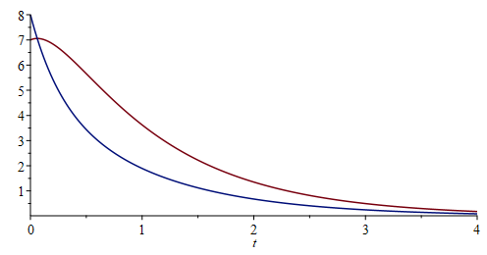
Solving a system of two initial-value problems
Here are these two functions:

Slide 18
Solving a system of four initial-value problems
For example,

Slide 19
Solving a system of four initial-value problems
As before, this system us described by this matrix:

Slide 20
Solving a system of four initial-value problems
The matrix A has these eigenvalues and eigenvectors

Slide 21
Solving a system of four initial-value problems
With these eigenvalue-eigenvector pairs, we claim the solution is
If you prefer:

Slide 22
Solving a system of four initial-value problems
Suppose we know that at time t = 0, we have the following initial conditions:
In this case, we have:

Slide 23
Solving a system of four initial-value problems
This defines the following system of linear equations:
The solution is:

Slide 24
Solving a system of four initial-value problems
Substituting these into our general solution:
If you prefer:

Slide 25
Solving a system of four initial-value problems
With this solution:
we note that these functions satisfy all these conditions:

Slide 26
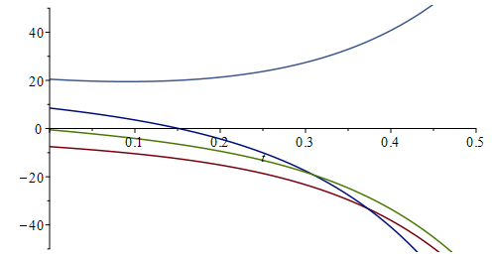
Solving a system of four initial-value problems
With this solution:
Note these functions satisfy all these conditions:

Slide 27
Summary
Following this topic, you now
Are aware that the eigenfunctions of the differential operator are the exponential functions
Understand that eigenvalues and eigenvectors can be used to find solutions to systems of initial-value problems
Know you are not required to understand the details for this course, but you are aware of how the differential equations are translated into a matrix
Are aware that in reality, you will not need to find the eigenvalues and eigenvectors explicitly, but rather, you would use software to find these

Slide 28
References
[1] https://en.wikipedia.org/wiki/Linear_differential_equation
[2] https://en.wikipedia.org/wiki/Eigenvalues_and_eigenvectors

Slide 29
Acknowledgments
None so far.

Slide 30
Colophon
These slides were prepared using the Cambria typeface. Mathematical equations use Times New Roman, and source code is presented using Consolas. Mathematical equations are prepared in MathType by Design Science, Inc.
Examples may be formulated and checked using Maple by Maplesoft, Inc.
The photographs of flowers and a monarch butter appearing on the title slide and accenting the top of each other slide were taken at the Royal Botanical Gardens in October of 2017 by Douglas Wilhelm Harder. Please see
https://www.rbg.ca/
for more information.

Slide 31
Disclaimer
These slides are provided for the ne 112 Linear algebra for nanotechnology engineering course taught at the University of Waterloo. The material in it reflects the authors’ best judgment in light of the information available to them at the time of preparation. Any reliance on these course slides by any party for any other purpose are the responsibility of such parties. The authors accept no responsibility for damages, if any, suffered by any party as a result of decisions made or actions based on these course slides for any other purpose than that for which it was intended.

